Slide 1
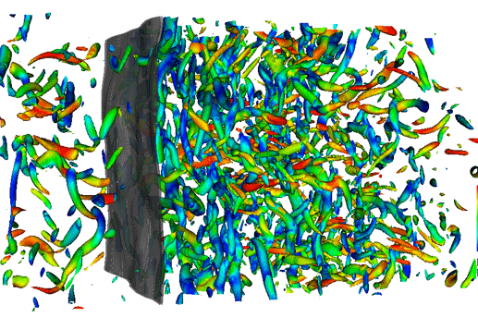

Study of unsteady shock motion in shock/turbulence interaction
Palash Sashittal
Yogesh Prasaad M S
Krishnendu Sinha
Indian Institute of Technology Bombay
And
Johan Larsson
University of Maryland
Larsson et al. JFM 2013
Notes:
Starting slide
Introduce yourselves
Explain little about the figure if necessary
Ensure that you will always direct the audience to the figures
Keep in mind that the average attention time from listeners is only 18 minutes.
Always make it interesting so that you could keep up the attention even after 20 minutes.

Slide 2
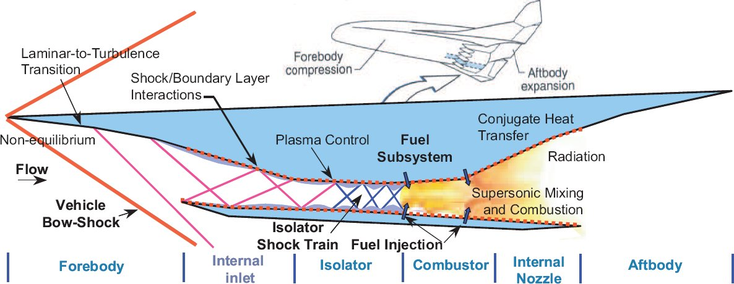
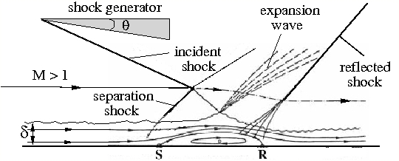
Motivation
Shock wave boundary layer interaction (SBLI)
High speed flow applications
Increased heating and pressure loads
Better flow control methodologies and novel aerospace vehicle designs
Stanford FPCE Group
Notes:
Transition point: Where do we find STI cases?
Motivation
Area of engineering interest is SBLI
Applied in high speed flow simulations
Implications and uses.
Explain about the top figure and then say that the bottom figure is an inset of the top one (something like that).

Slide 3
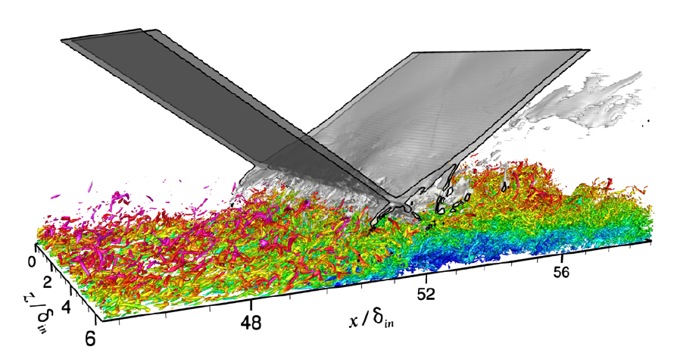
SBLI – Physics
Shock unsteadiness – important physics
Fluctuating heat and pressure loads
Mechanisms of shock unsteadiness
incoming turbulent boundary layer (Ganapathisubramani et al., 2007)
‘breathing ‘ of separation bubble (Wu and Martin, 2008 and Priebe and Martin, 2012)
Pirozzoli and Bernardini, AIAA 2011
Notes:
Transition point: One of the important physics in SBLI is shock unsteadiness which is of our interest
Implications of shock unsteadiness
Use the figure to show it
Explain the mechanisms behind shock unsteadiness and expand on the literature

Slide 4
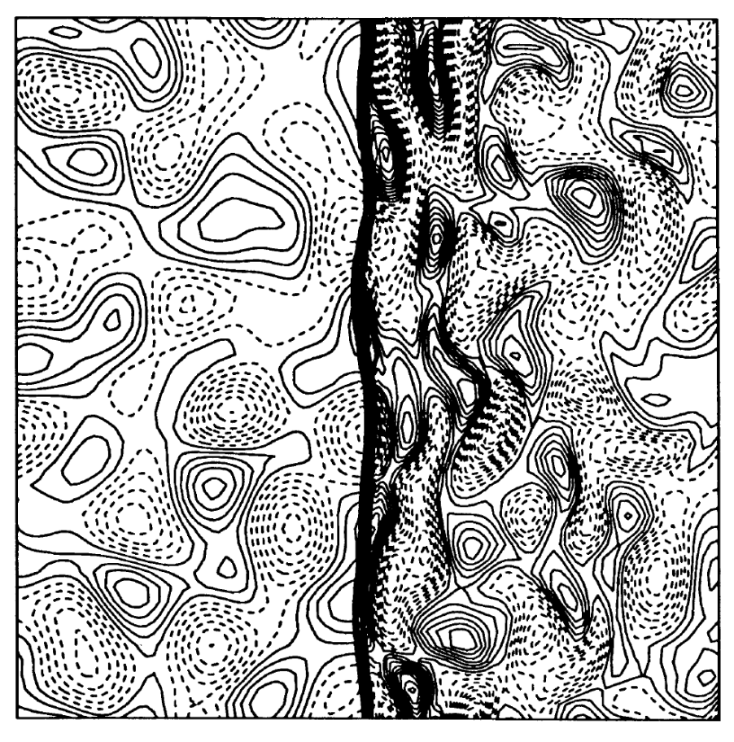
Model problem
Isotropic turbulence interacting with shock
DNS: Lee et al. 1993, 1997 Jamme et al. 2002 Larsson et al. 2009, 2013
Theoretical: Ribner 1953, 1954 Cambon et al. 1993 Mahesh et al. 1996 Donzis 2012
Experimental: Hesselink &Sturtevant 1988 Barre et al. 1996 Andreopoulos et al. 2000
M >1
Lee et al. JFM 1993
Notes:
Transition point: We need to frame a model problem to understand shock unsteadiness
Say about model problem and who have all studied it and the methods they used to study. (Maybe include one more reference in experiments side)
Explain the figure clearly and emphasize on shock unsteadiness

Slide 5
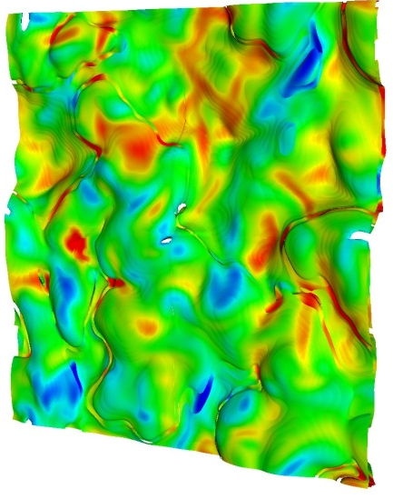
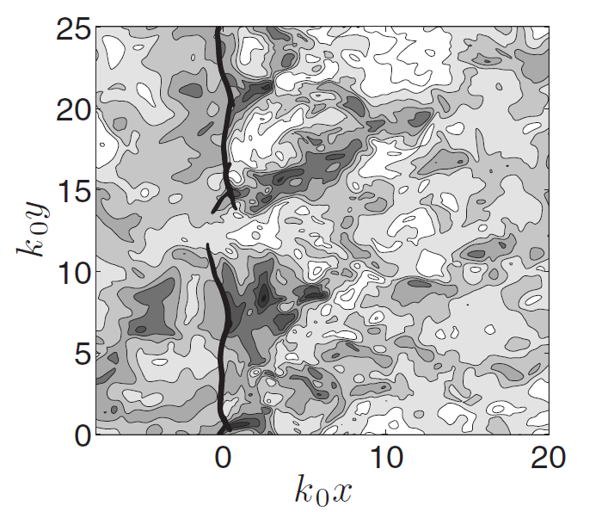
Shock holes
Region of smooth compression
Criteria for shock holes in 3D (Donzis 2012, Larsson et al 2013)
M_{t} ≥ 0.6 (M-1)
Equivalent criteria in 1D
u′ / a ≥ 0.35 (M-1)
Zank et al., 2002 – Destabilization of 1D Burgers’ shock (> 5% turbulence)
Larsson et al. PoF 2009
Notes:
Transition point: We have seen that the shock distorts with interaction of turbulence and at very high amplitudes they tend to develop an interesting feature called shock holes
Explain shock holes and explain Larsson’s figure on right side
Say about the criteria for shock holes and emphasize that they are from DNS only and can vary.
Explain about Zank’s destabilization critera.

Slide 6
Objectives of current work
Can one-dimensional (1D) Euler shock be broken using either single mode or broadband perturbations?
Effects of turbulence on shock
Can 3D shock turbulence interaction be replicated in 1D environment?
Comparison of shock statistics – correlations
Qualitative understanding – multi–dimensional phenomena?
Notes:
Transition point: With Zank’s work in mind, we frame our objectives.
Explain that we are studying the effects of turbulence on shock dynamics and how it will develop shock holes
That we used shock statistics to check the inherently one dimensional effects and multi dimensional effects

Slide 7
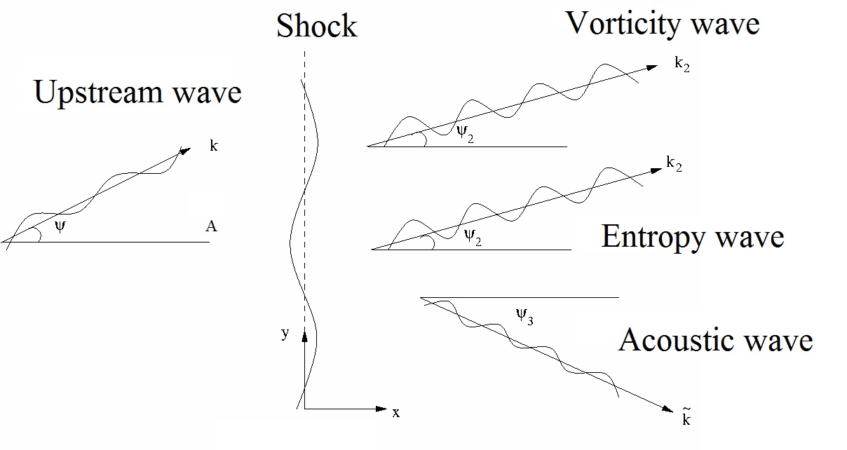
Linear Interaction Analysis (Ribner 53, 54)
Turbulence decomposed into three modes (Kovasznay, 1953)
Linear superposition of modes (in the linear limit) as solution
Notes:
Transition point: With the objectives set, we look at the tools that can be used to solve the model problem. One such theoretical tool is LIA.
Explain about the modes
What are all the effects captured by LIA
Refer the audience to KM’s work on extensive usage details of LIA

Slide 8
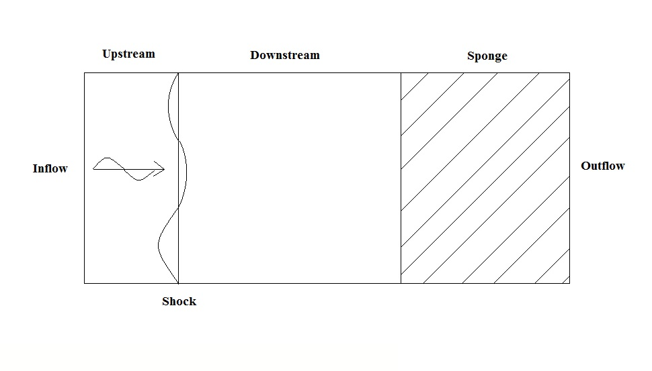
Numerical method
Euler equations of mass, momentum and energy (1D only)
Sinusoidal fluctuations superposed at inflow
Notes:
Transition point: Next we look at the numerical tool – DNS which is used to study STI in this work.
Explain the figure
Say that this would be the tool to analyze stuff
Explain the inflow conditions and say something about the code.

Slide 9
Outflow conditions: minimize shock drift and spurious noise
Sponge region – minimize spurious reflections
Shock drift velocity < 1% upstream mean velocity
Variation of shock position for a high amplitude single mode entropy wave interacting with a shock wave
Notes:
Transition point: Next we look at the outflow conditions, where two controls have been used to reduce the errors to a minimum
Sponge region will be covered later
Iterative back pressure control to reduce shock drift
Always keeping shock drift velocity to be less than 1% after initial transient

Slide 10
Error analysis – Grid convergence
Combination of acoustic/vorticity/entropy
Broadband of acoustic waves
Color | Red | Green | Blue | Black
Grid size | π/50 | π/100 | π/200 | π/400
Notes:
Transition point: Now that the conditions have been set, it is essential that the errors in simulations be as small as possible. For this, first we perform the grid convergence study
Explain that 4 different grid resolutions have been tried.
Say that the error is less than 3% - within the limits
Prof. Larsson: Redo the figures with the normalization by upstream shock values - not doing 1) the figures become very ugly and the error tolerance is increased since the mean shock location is different for different grids 2) this was already used in the paper, so why change it.

Slide 11
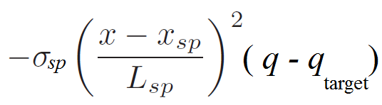
Error analysis – Sponge convergence
Sponge region – prevent reflections from outflow
Reflection coefficient from end of the sponge
α_{d} ~ σ_{sp} L_{sp}
Reflection coefficient from inside the sponge
α_{r} ~ 1 / σ_{sp}
Coefficients are independent but not the parameters
Notes:
Prof. Larsson – insert the equation here and use it to explain. – Done.
Transition point: The sponge region is analyzed next for minimizing the errors.
Explain the points clearly.
Use an image of disturbances from the end of the domain as well as from inside the sponge

Slide 12
Error analysis – Sponge convergence
Combination of acoustic/vorticity/entropy
Broadband of acoustic waves
Color | Length | Strength | Normalized α_{r} | Normalized α_{d}
Red | 1 π | 2.0 | 1 | 1
Green | 4 π | 1.0 | 2 | 2
Blue | 16 π | 0.5 | 4 | 4
Notes:
The same error metric is used. Error is within limits
Explain the axis and the normalization clearly to prevent misunderstanding.
Also mention about time consistency since the variances did not change when halving the time period, but not shown here.

Slide 13
Results
Notes:
Transition point: The errors in the simulations have been identified now. We will look at the results from the simulations.

Slide 14
Breaking the shock
Wave mode | Fluctuation amplitude | u_{rms} / a
Entropy single mode | 10% 30% 50% 80%
Right moving acoustic single mode | 10% 30% 50% 80% | 0.071 0.214 0.357 0.571
Right moving acoustic broadband |  | 0.15 0.225 0.3
Left moving acoustic broadband |  | 0.15 0.225 0.3
Shock breaking criteria u_{rms}/a ~ 0.175 for M 1.5 normal shock [Donzis (2012) Larsson et al. (2013)] is exceeded in the cases
Notes:
Transition point: We will now look at the first objective which is to break the shock using planar waves.
For this, we attempted the amplitudes in fluctuations as shown in table for different types of waves. We exceeded the equivalent criteria posed by Donzis.
Entropy waves do not have upstream velocity fluctuations and thus urms/a = 0
Similarly, the broadband cases have varying amplitudes in the inflow and thus there are no single valued fluctuation amplitudes.

Slide 15
Can a single mode entropy wave break the shock?
30% fluctuations
80% fluctuations
Clear distinct wavy line – jumps are identifiable
Notes:
Transition point: First, we check whether an entropy wave alone can break the shock.
Explain why vorticity mode cannot be used….
Pressure Contours in x-t plane are shown
Increase in amplitude increases the shock waviness.
No time interval of smooth gradients – shock not broken

Slide 16
Can a single mode acoustic wave break the shock?
50% fluctuations
80% fluctuations
Sharp jump in pressure is identifiable
Notes:
Contours for acoustic wave interaction with shock
Certain time intervals – smooth gradient – shock could be broken
Increase in amplitude would result in negative pressures
High amplitude waviness – not seen – could be due to shock-shock interactions

Slide 17
Can acoustic broadband waves break the shock?
Left moving – 20%
Right moving – 20%
Intact shock for higher intensities in velocity field
Notes:
Acoustic broadband cases were considered with 20% amplitude in velocity field. This corresponds to 30% in turbulent Mach number upon mean Mach number.
Distinct pressure jumps are identified.
Left moving and right moving acoustic broadband cases are completely different.
Shock still not broken.

Slide 18
Replicate 3D features in 1D interactions
DNS database of 3D shock turbulence interaction
Re_{λ} 40, M 1.5 and M_{t} 0.16
Corresponds to 10% fluctuation levels for planar waves
Sinusoidal single mode entropy wave interacting with a shock giving rise to sinusoidal fluctuations downstream
Notes:
Transition point: We have seen visually that the shock cannot be broken in 1D case. Can we statistically show that it is difficult to break the shock in 1D? The second objective is to study statistical correlations between full DNS and 1D simulations.
The case of intact shock is considered to know the relations between 1D planar wave interactions and 3D shock turbulence interaction problems.
Different wave types interaction with shock are considered. Sinusoidal fluctuations giving sinusoidal solutions.

Slide 19
Cases and terminologies
Wave mode | Fluctuation amplitude | u_{rms} / a
Entropy single mode | 10%
Right moving acoustic single mode | 10% | 0.071
Left moving acoustic single mode | 10% | 0.071
Right moving acoustic broadband |  | 0.15
Left moving acoustic broadband |  | 0.15
Shock position – using half pressure rise and linear interpolation
Shock strength (θ) – using jump in density values from just upstream and downstream of shock
Notes:
Transition point: We have seen visually that the shock cannot be broken in 1D case. Can we statistically show that it is difficult to break the shock in 1D? The second objective is to study statistical correlations between full DNS and 1D simulations.
The case of intact shock is considered to know the relations between 1D planar wave interactions and 3D shock turbulence interaction problems.
Different wave types interaction with shock are considered. Sinusoidal fluctuations giving sinusoidal solutions.

Slide 20
Correlations of shock speed (u′_{s}) with shock position (x′_{s})
Zero correlation at zero time lag is observed in all cases – shock position is integral of shock speed
Positive shock speed – pushed back shock
Single mode waves
Broadband of waves
Notes:
Prof. Larsson: Titles and legends are must. – Partially done to avoid cluttering
Transition point: We now look at correlations of shock speed with different quantities of the shock as well as turbulence and try to draw inferences that could help in understanding the difference between 1D and 3D interactions
Explain about the figures clearly.
Left moving acoustic broadband case is closer to 3D case.
Symmetric and asymmetric.

Slide 21
Correlations of shock speed (u′_{s}) with upstream velocity fluctuations (u′_{u})
Periodic variations with changes in time lag – single mode
High intensity velocity fluctuations – positive shock speed
Single mode waves
Broadband of waves
Notes:
Transition point: Now we look at the correlations of upstream velocity fluctuations and shock speed.
Explain the figures.
Emphasize that shock speed is directly correlated with upstream velocity fluctuations

Slide 22
Correlations of shock speed (u′_{s}) with shock strength (θ′)
Negative time lag – positive shock speed followed by stronger shock -- negative shock speed followed by weaker shock
Pushed back shock is stronger
Single mode waves
Broadband of waves
Notes:
Transition point: Now we look at the correlations of shock strength and shock speed.
Explain the figures.
Show that the shock holes have zero strength and the negative time lag and the pushed back shock to make the case that the shock holes are different in 1D and 3D.

Slide 23
Summary
1D Euler shock is very difficult to break even at very high amplitudes
1D broadband left moving acoustic waves show similar features as 3D shock turbulence interaction
Correlations support qualitative difference between 1D cases and 3D cases in terms of shock holes

Slide 24
Thank you Any questions?

